Slide 1

Chapter 13 Part 2
Business Intelligence and Data Warehouses
The slides in this presentation have been adapted from slides provided with the textbook, Database Systems: Design, Implementation, and Management,
12E, Cornel and Morris, Copyright © 2017 Cengage Learning.

Slide 2
Learning Objectives
About the relationship and differences between operational data and decision support data
What a data warehouse is and how to prepare data for one
What star schemas are and how they are constructed
Copyright © 2017 Cengage Learning
2

Slide 3
The Need for Data Analysis
Managers track daily transactions to evaluate how the business is performing
Strategies should be developed to meet organizational goals using operational databases
Data analysis provides information about short-term tactical evaluations and strategies
Copyright © 2017 Cengage Learning
3

Slide 4
Decision Support Data
Effectiveness of BI depends on quality of data gathered at operational level
Operational data
Seldom well-suited for decision support tasks
Stored in relational database with highly normalized structures
Optimized to support transactions representing daily operations
Copyright © 2017 Cengage Learning
4

Slide 5
Decision Support Data
Differ from operational data in:
Time span
Granularity
Drill down: Decomposing a data to a lower level
Roll up: Aggregating a data into a higher level
Dimensionality
Copyright © 2017 Cengage Learning
5

Slide 6
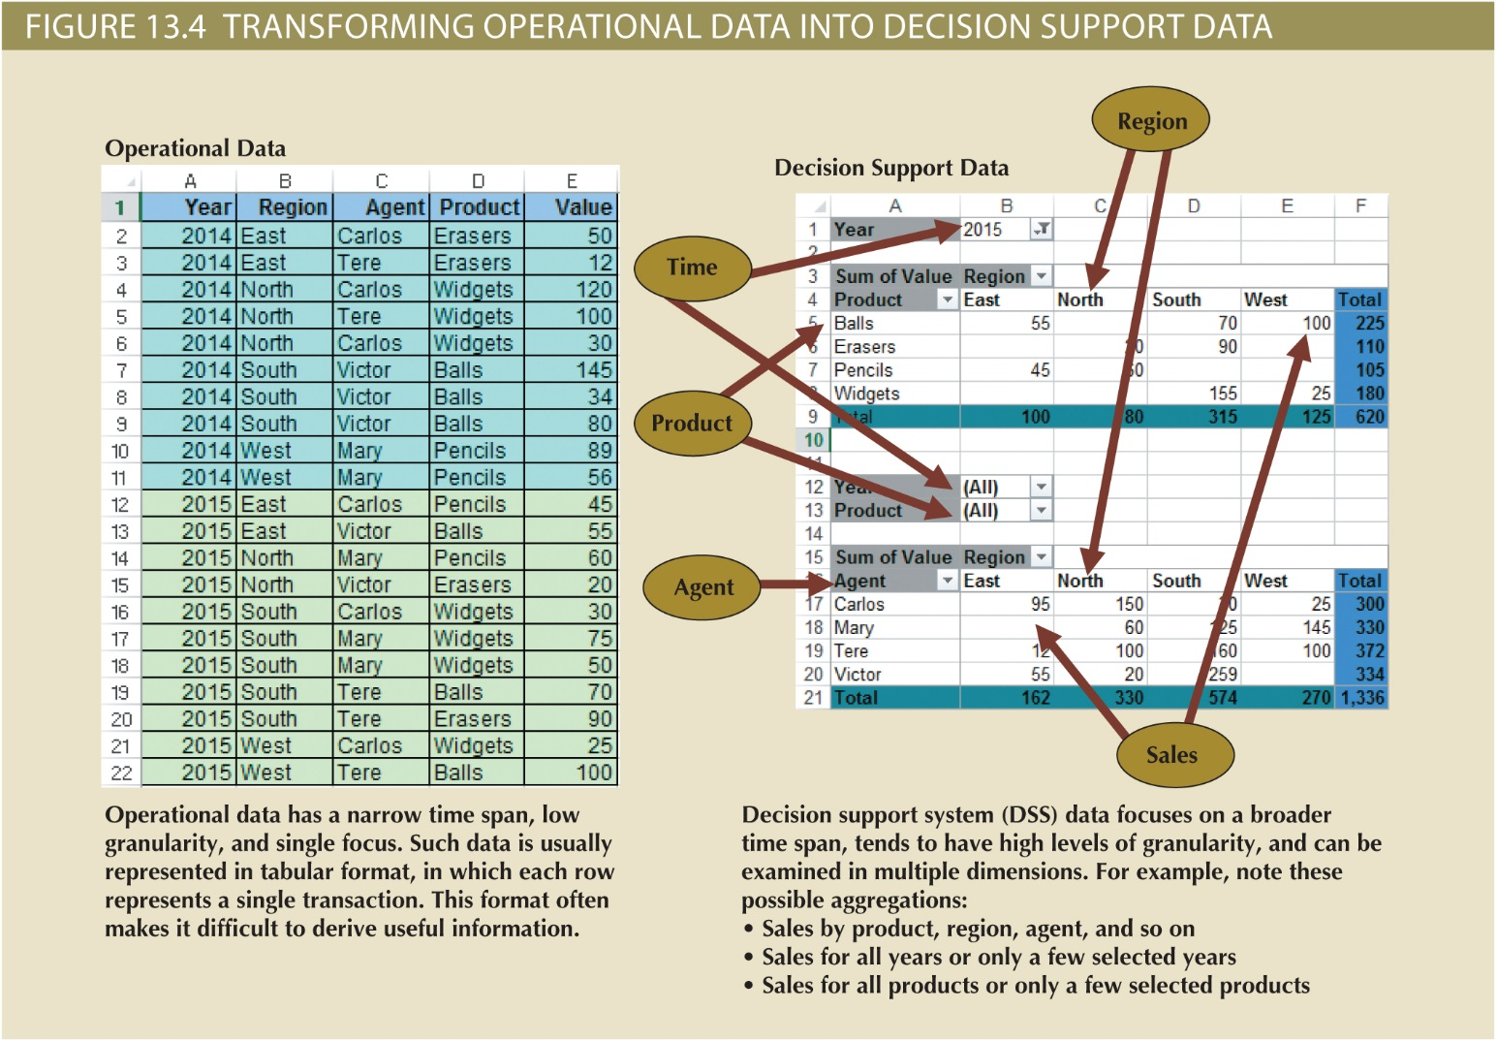
Copyright © 2017 Cengage Learning
6

Slide 7
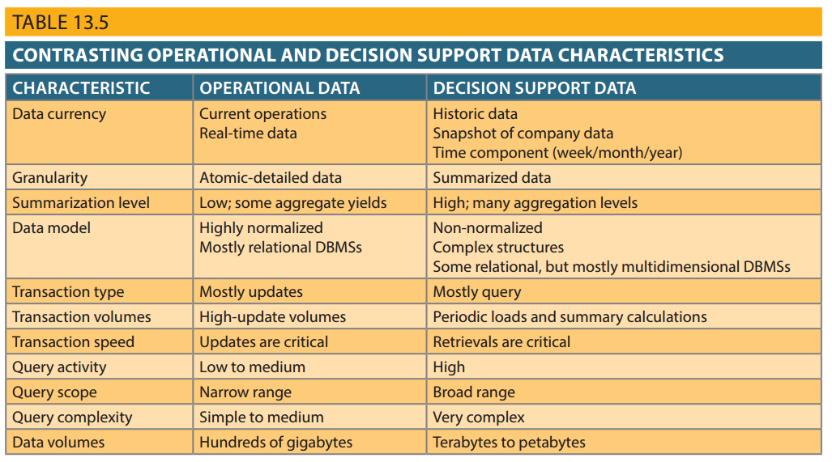
Copyright © 2017 Cengage Learning
7

Slide 8
Decision Support Database Requirements
Database schema
Must support complex, non-normalized data representations
Data must be aggregated and summarized
Queries must be able to extract multidimensional time slices
Copyright © 2017 Cengage Learning
8

Slide 9
Decision Support Database Requirements
Data extraction and loading
Allow batch and scheduled data extraction
Support different data sources and check for inconsistent data or data validation rules
Support advanced integration, aggregation, and classification
Database size should support:
Very large databases (VLDBs)
Advanced storage technologies
Multiple-processor technologies
Copyright © 2017 Cengage Learning
9

Slide 10
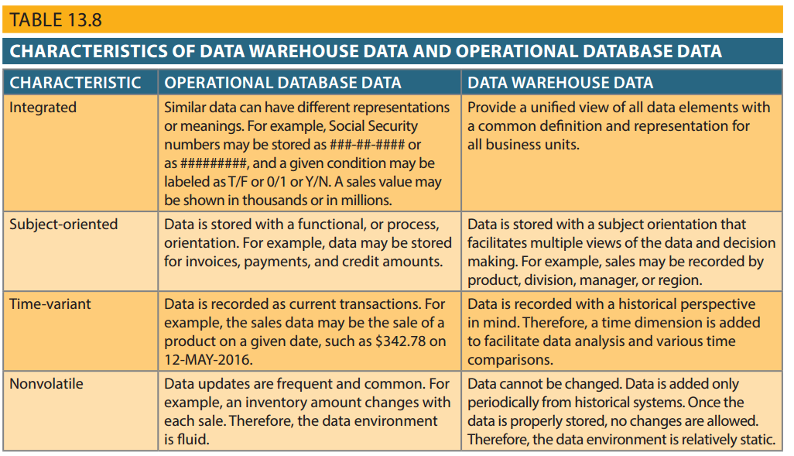
Copyright © 2017 Cengage Learning
10

Slide 11
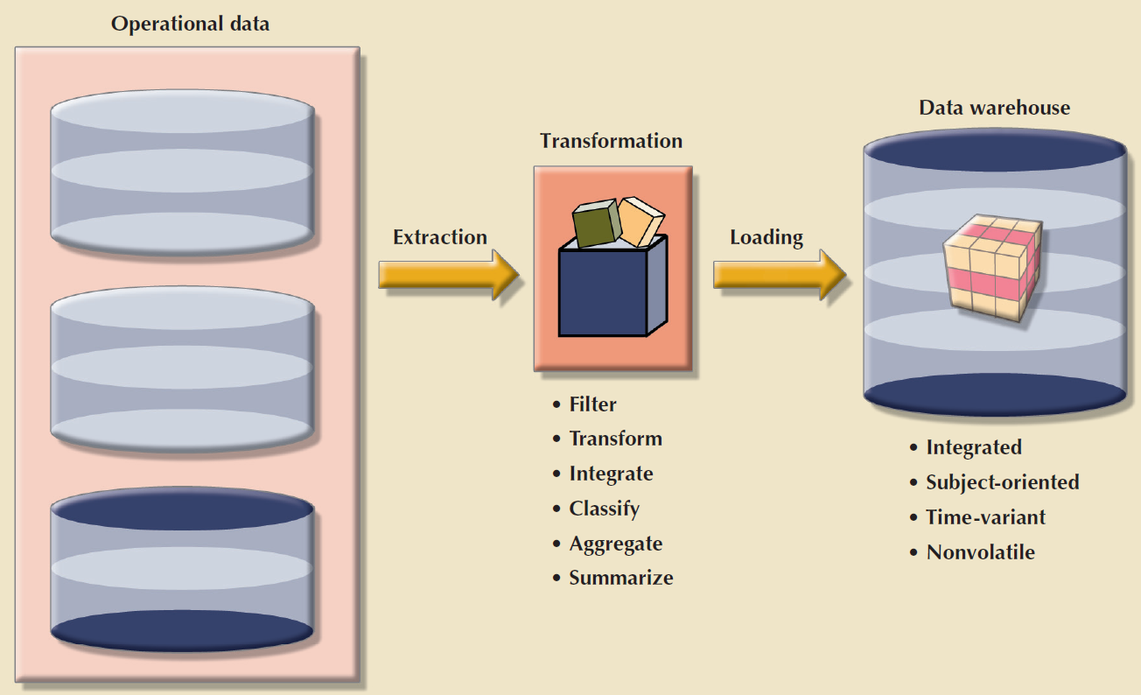
Copyright © 2017 Cengage Learning
11

Slide 12
Data Marts
Small, single-subject data warehouse subset
Provide decision support to a small group of people
Benefits over data warehouses
Lower cost and shorter implementation time
Technologically advanced
Inevitable people issues
Copyright © 2017 Cengage Learning
12

Slide 13
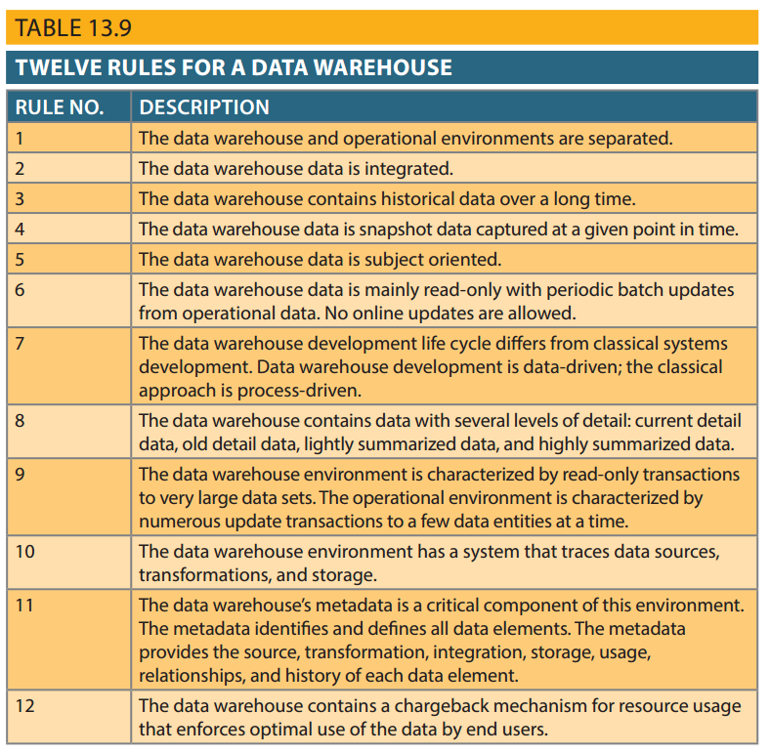
Table 13.9 - Twelve Rules for a Data Warehouse
Copyright © 2017 Cengage Learning
13

Slide 14
Star Schema
Data-modeling technique
Maps multidimensional decision support data into a relational database
Creates the near equivalent of multidimensional database schema from existing relational database
Yields an easily implemented model for multidimensional data analysis
Copyright © 2017 Cengage Learning
14

Slide 15
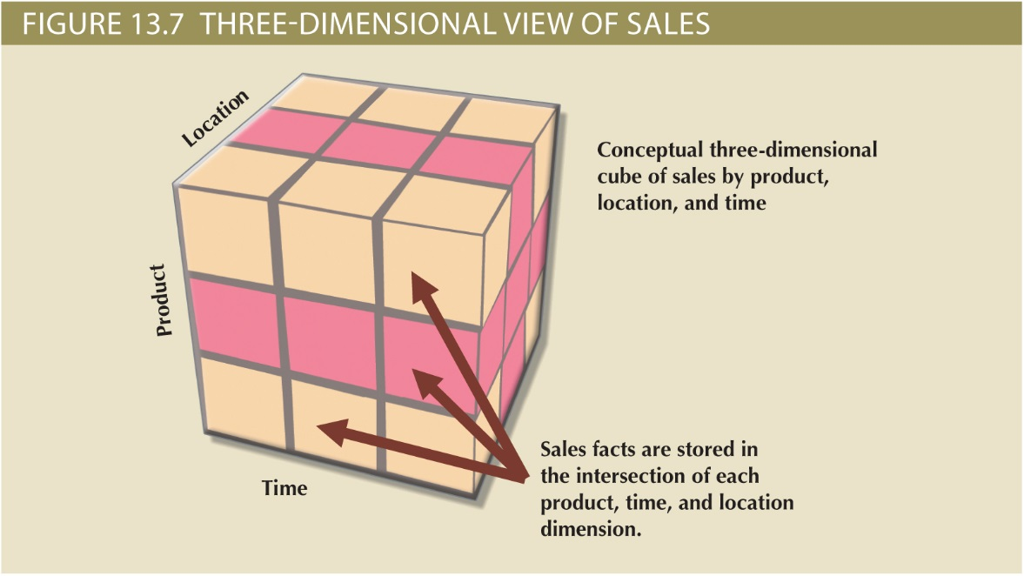
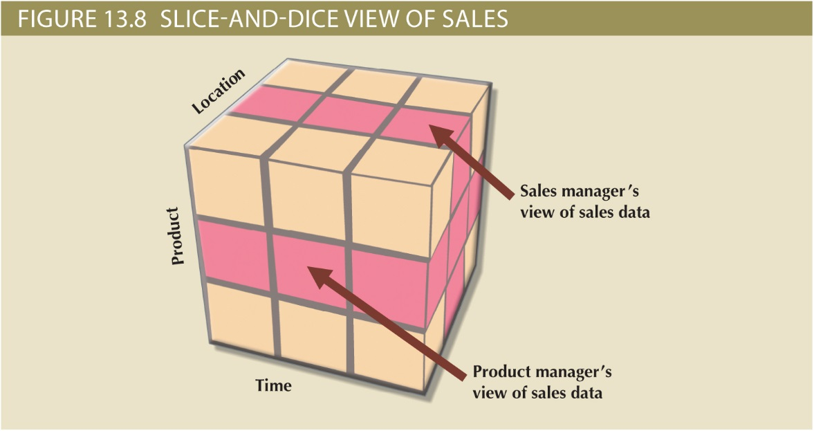
Dimensional View of Sales
Copyright © 2017 Cengage Learning
15

Slide 16
Components of Star Schemas
Facts
Numeric values that represent a specific business aspect
Dimensions
Qualifying characteristics that provide additional perspectives to a given fact
Attributes
Used to search, filter, and classify facts
Slice and dice: Ability to focus on slices of the data cube for more detailed analysis
Attribute hierarchies
Provides a top-down data organization
Copyright © 2017 Cengage Learning
16

Slide 17
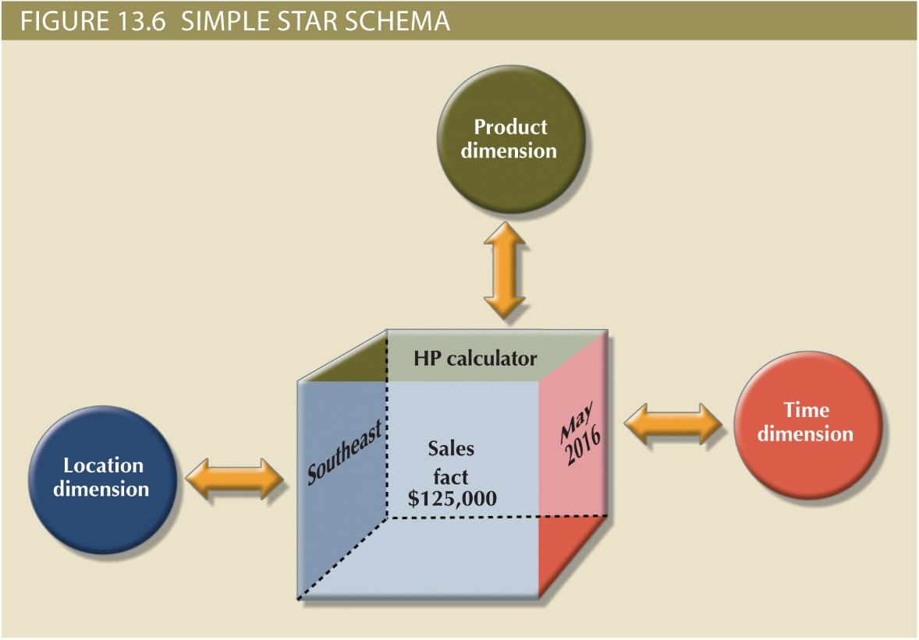
A Cell within a Dimensional View of Sales
Copyright © 2017 Cengage Learning
17

Slide 18
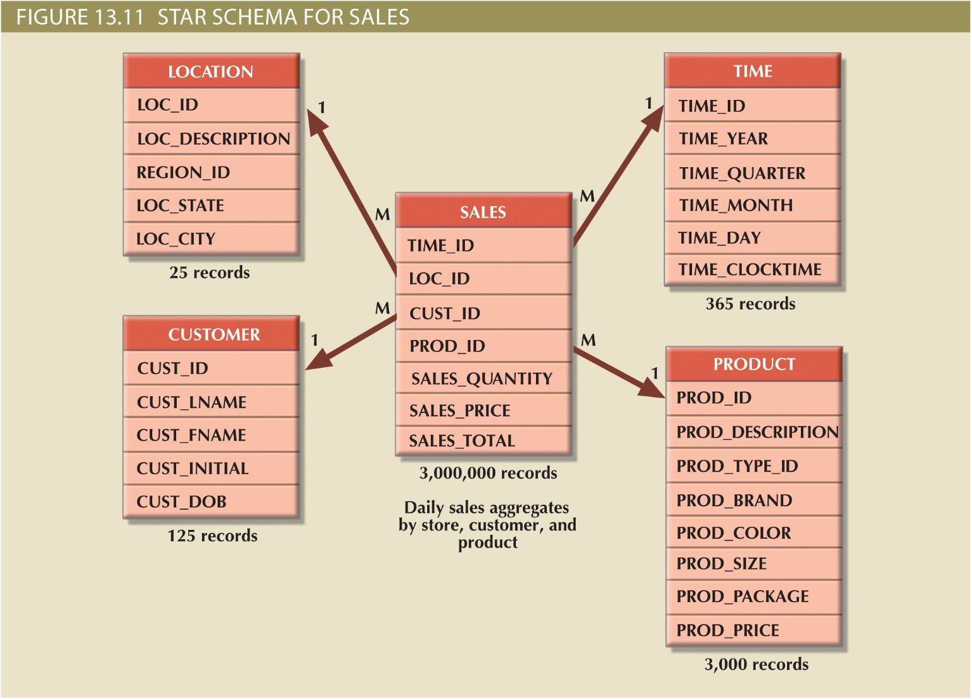
Star Schema Sales
Copyright © 2017 Cengage Learning
18

Slide 19
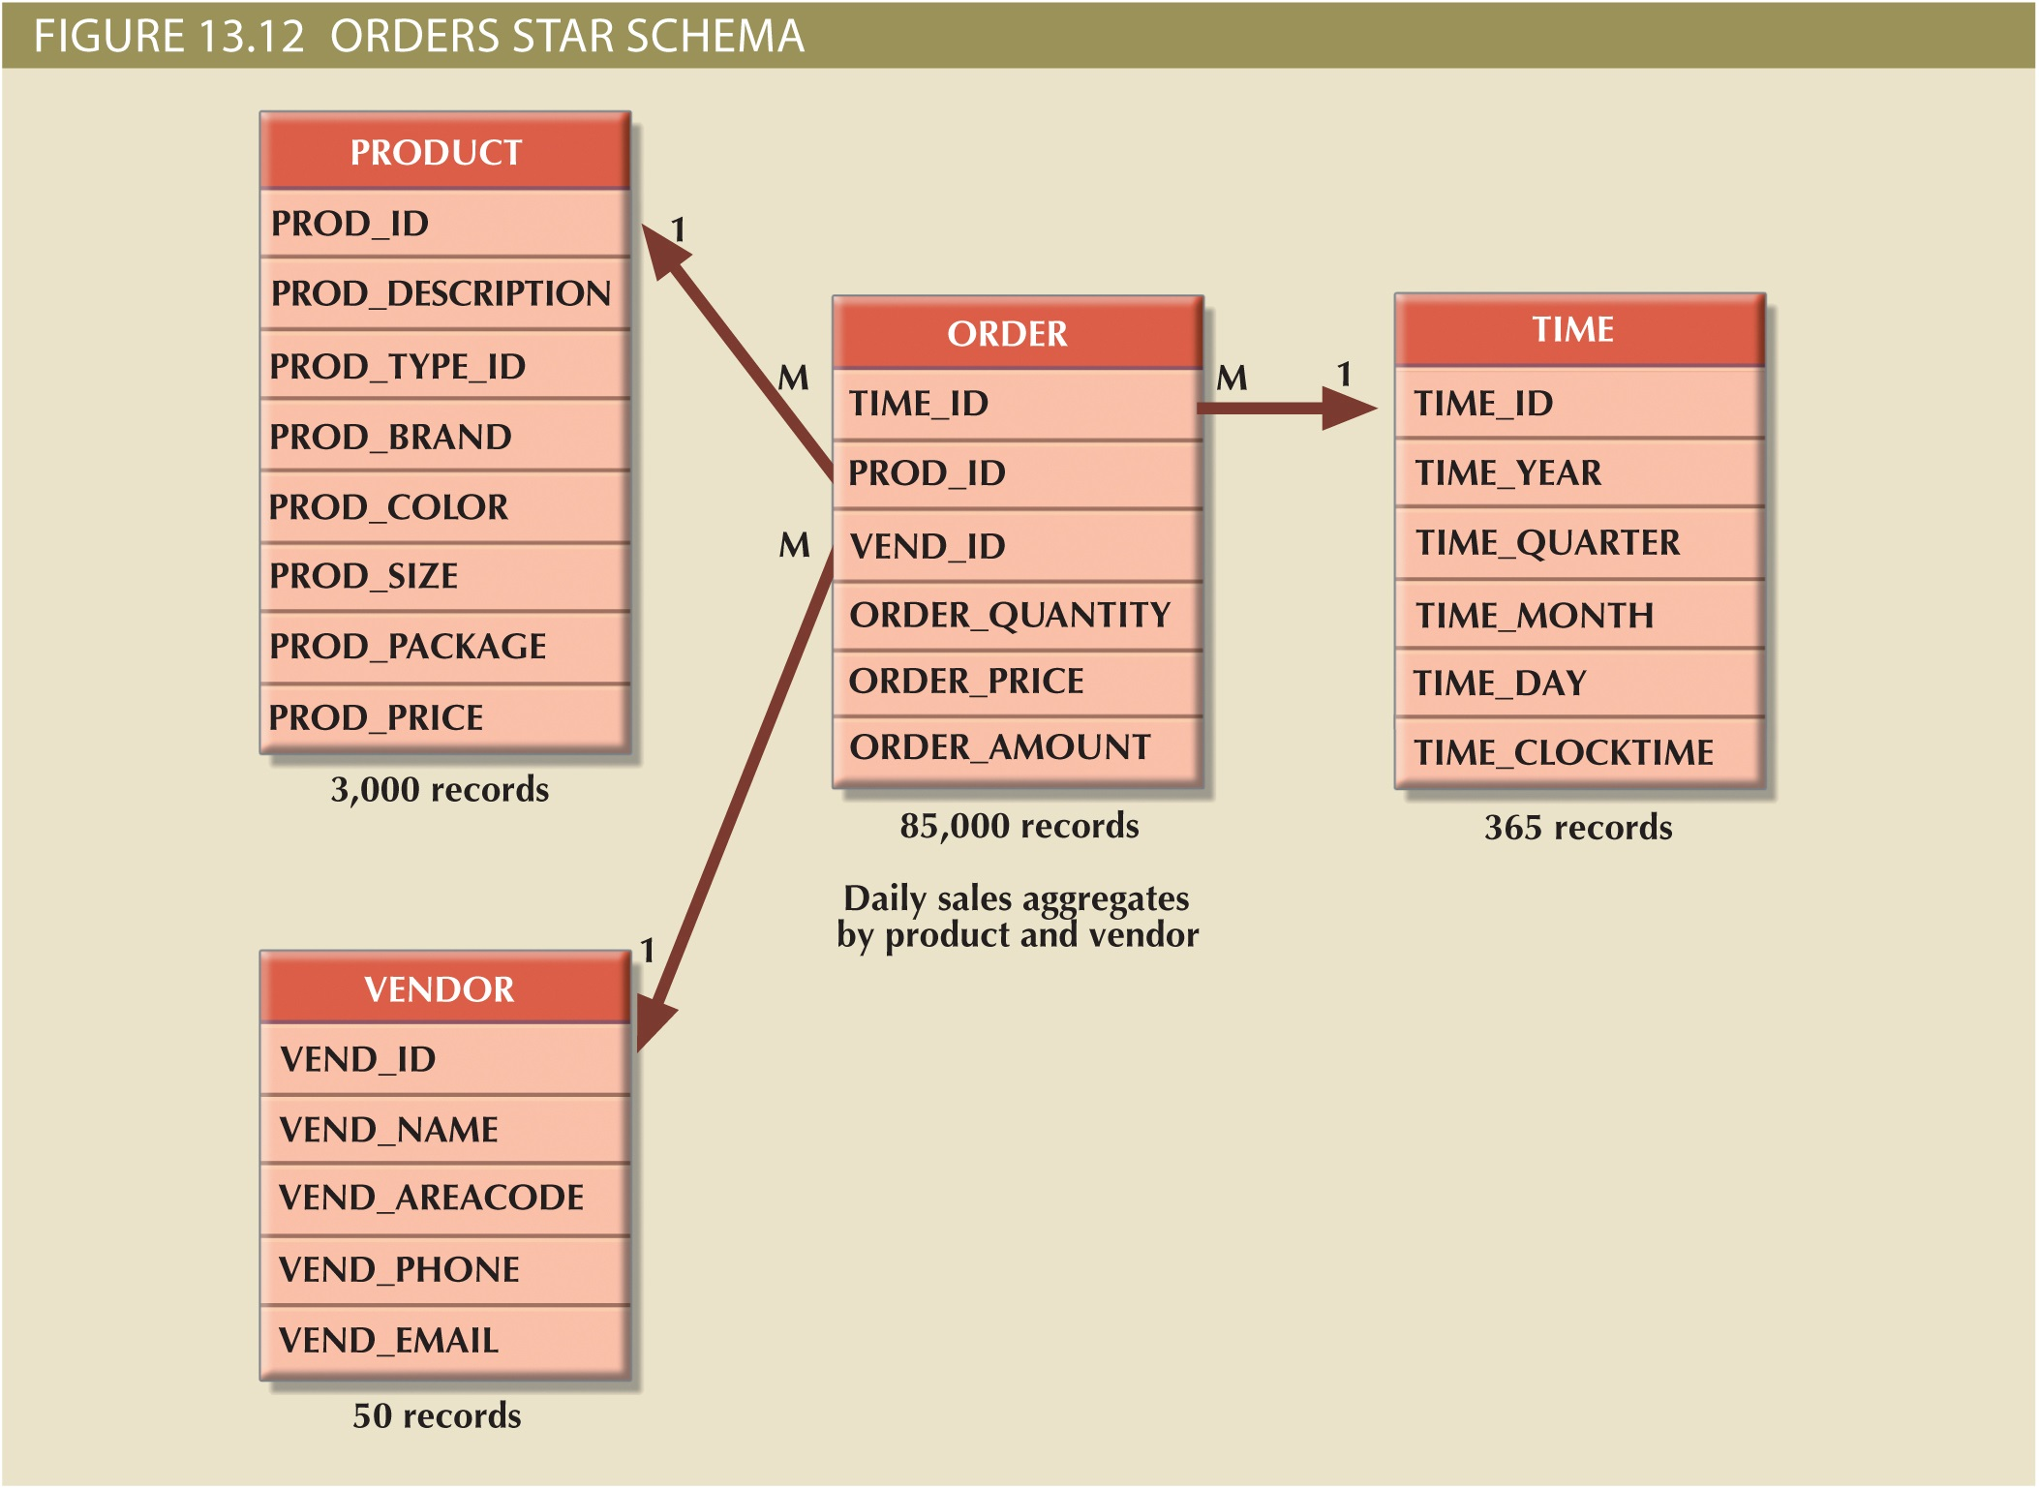
Copyright © 2017 Cengage Learning
19

Slide 20
Star Schema Representation
Facts and dimensions represented by physical tables in data warehouse database
Many-to-one (M:1) relationship between fact table and each dimension table
Fact and dimension tables
Related by foreign keys
Subject to primary and foreign key constraint
Primary key of a fact table
Can be a composite primary key because the fact table is related to many dimension tables
Rarely need to perpetuate fact table keys
Copyright © 2017 Cengage Learning
20

Slide 21
Copyright © 2017 Cengage Learning
21

Slide 22
Techniques Used to Optimize Data Warehouse Design
Normalizing dimensional tables
Snowflake schema: Dimension tables can have their own dimension tables
Maintaining multiple fact tables to represent different aggregation levels
Denormalizing fact tables
Copyright © 2017 Cengage Learning
22

Slide 23
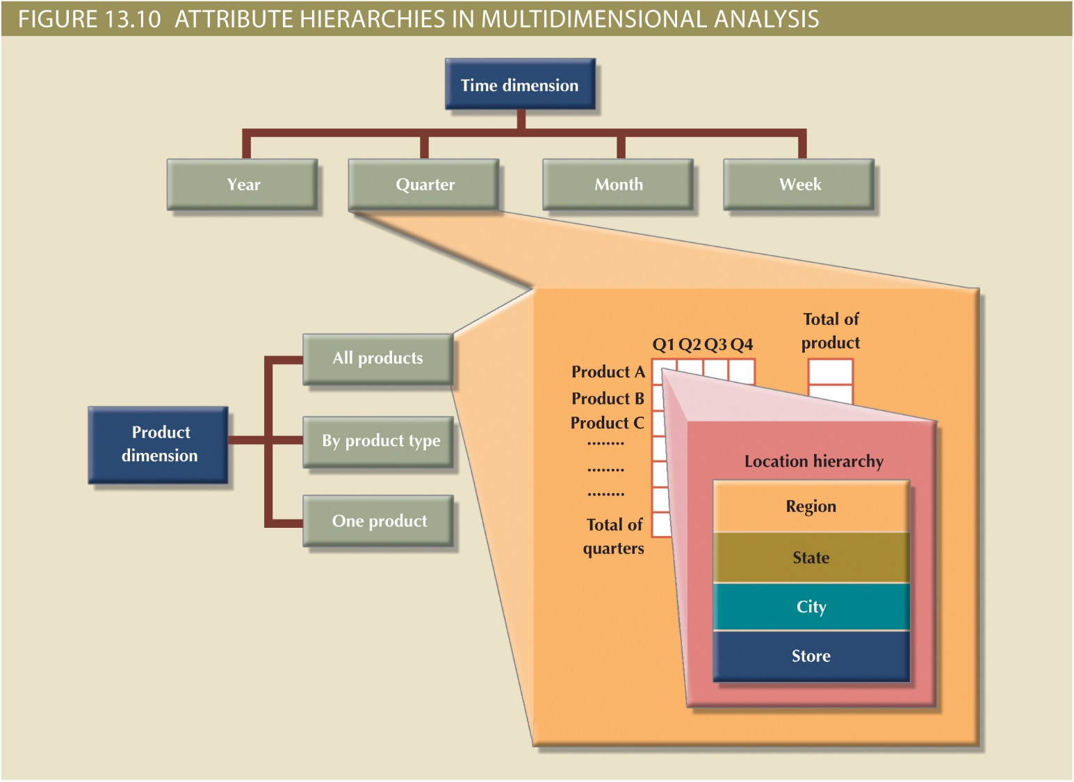
Copyright © 2017 Cengage Learning
23

Slide 24
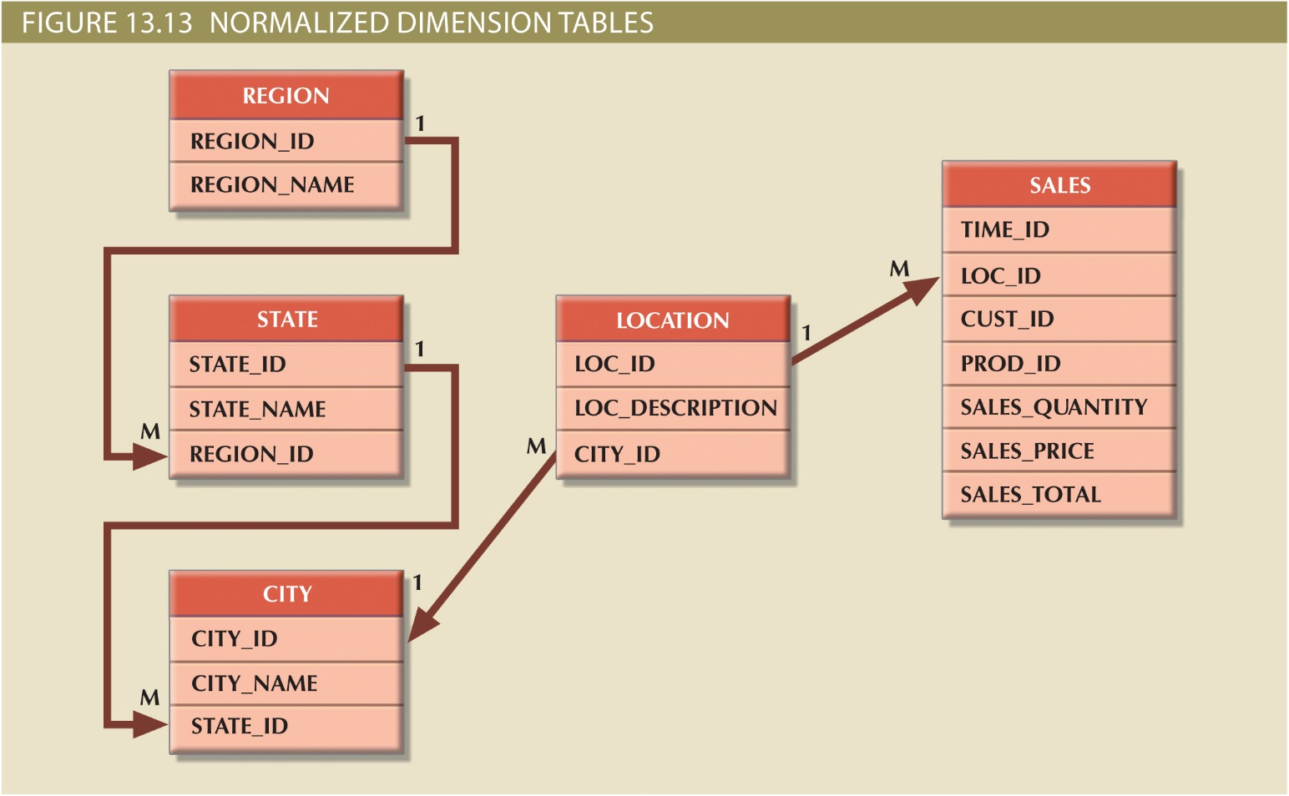
Copyright © 2017 Cengage Learning
24

Slide 25
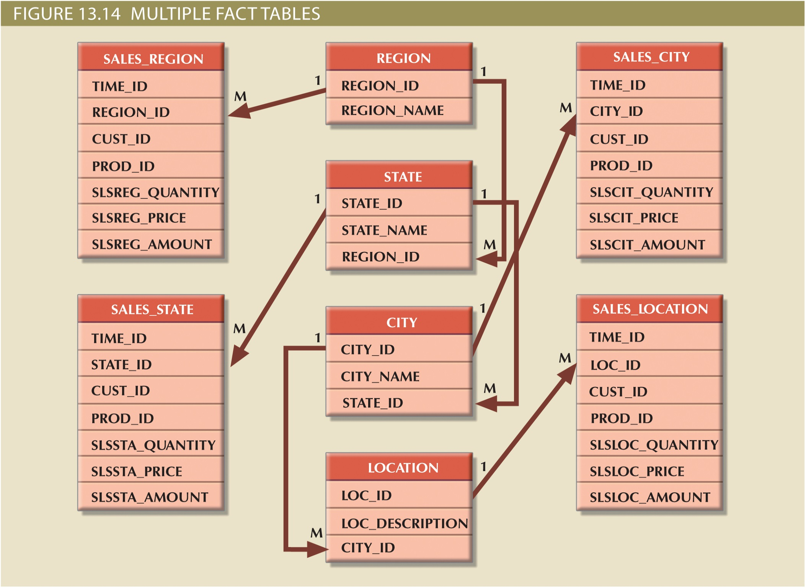
Snowflake Schema
Copyright © 2017 Cengage Learning
25

Slide 26
Techniques Used to Optimize Data Warehouse Design
Partitioning and replicating tables
Partitioning: Splits tables into subsets of rows or columns and places them close to customer location
Replication: Makes copy of table and places it in a different location
Periodicity: Provides information about the time span of the data stored in the table
Copyright © 2017 Cengage Learning
26

Slide 27
Summary
Operational data not suited for decision support
Data warehouse provides support for decision making
Usually read-only
Optimized for data analysis, query processing
Star schema is a data-modeling technique
Maps multidimensional decision support data into a relational database
Star schema has four components:
Facts, dimensions, attributes, and attribute hierarchies
Copyright © 2017 Cengage Learning
27

Slide 28
Task
Convert the snowflake schema on slide 19 to UML class diagram notation.
Copyright © 2017 Cengage Learning
28

